Slide 1
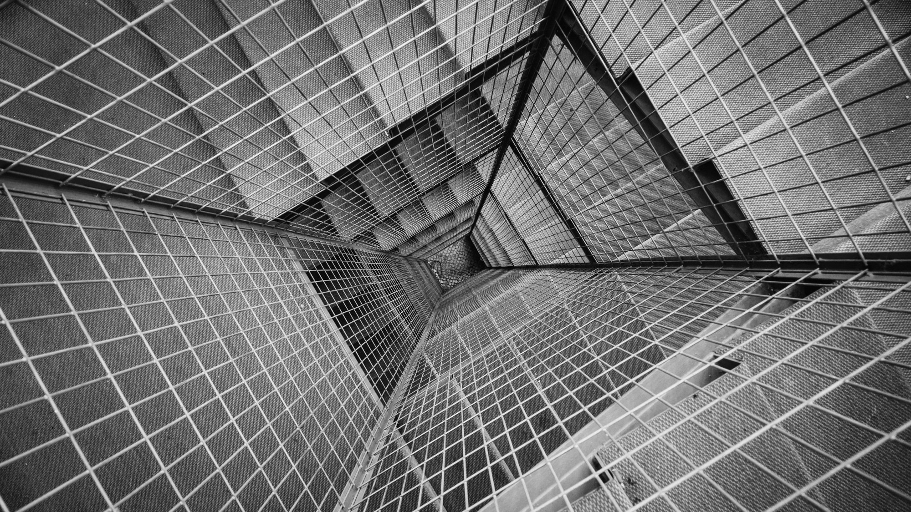
TOTAL TECHNOLOGY
REPORTLAB COMPLETE TUTORIAL
Table in Reportlab
Create table with alternate row & column background
Tutorial 30

Slide 2
How to create table with rowbackground color
from reportlab.platypus import Paragraph,SimpleDocTemplate,Table,TableStyle
from reportlab.lib import colors
pdf=SimpleDocTemplate("tutorial30.pdf")
flow_obj=[]
data=[[1,2,3,4,5],
[1,2,3,4,5],
[1,2,3,4,5]]
t=Table(data,colWidths=[40 for i in range(1,6)],rowHeights=[40 for i in range(1,4)])
tstyle=TableStyle([("GRID",(0,0),(-1,-1),2,colors.red),
("ROWBACKGROUNDS",(0,0),(-1,-1),[colors.black,colors.yellow,colors.blue])])
t.setStyle(tstyle)
flow_obj.append(t)
pdf.build(flow_obj)
TOTAL TECHNOLOGY

Slide 3
How to create table with coloumn background color
from reportlab.platypus import Paragraph,SimpleDocTemplate,Table,TableStyle
from reportlab.lib import colors
pdf=SimpleDocTemplate("tutorial30.pdf")
flow_obj=[]
data=[[1,2,3,4,5],
[1,2,3,4,5],
[1,2,3,4,5]]
t=Table(data,colWidths=[40 for i in range(1,6)],rowHeights=[40 for i in range(1,4)])
tstyle=TableStyle([("GRID",(0,0),(-1,-1),2,colors.red),
("COLBACKGROUNDS",(0,0),(-1,-1),[colors.black,colors.yellow,colors.blue])])
t.setStyle(tstyle)
flow_obj.append(t)
pdf.build(flow_obj)
TOTAL TECHNOLOGY

Slide 4
How to create chess board pattern
from reportlab.platypus import Paragraph,SimpleDocTemplate,Table,TableStyle
from reportlab.lib import colors
pdf=SimpleDocTemplate("tutorial30.pdf")
flow_obj=[]
data=[[1,2,3,4,5,6,7,8],
[1,2,3,4,5,6,7,8],
[1,2,3,4,5,6,7,8],
[1,2,3,4,5,6,7,8],
[1,2,3,4,5,6,7,8],
[1,2,3,4,5,6,7,8],
[1,2,3,4,5,6,7,8],
[1,2,3,4,5,6,7,8]]
t=Table(data,colWidths=[50 for i in range(1,9)],rowHeights=[50 for i in range(1,9)])
tstyle=TableStyle([("GRID",(0,0),(-1,-1),2,colors.red),
("COLBACKGROUNDS",(0,0),(-1,-8),[colors.black,colors.white]),
("COLBACKGROUNDS",(0,1),(-1,-7),[colors.white,colors.black]),
("COLBACKGROUNDS",(0,2),(-1,-6),[colors.black,colors.white]),
("COLBACKGROUNDS",(0,3),(-1,-5),[colors.white,colors.black]),
("COLBACKGROUNDS",(0,4),(-1,-4),[colors.black,colors.white]),
("COLBACKGROUNDS",(0,5),(-1,-3),[colors.white,colors.black]),
("COLBACKGROUNDS",(0,6),(-1,-2),[colors.black,colors.white]),
("COLBACKGROUNDS",(0,7),(-1,-1),[colors.white,colors.black])])
t.setStyle(tstyle)
flow_obj.append(t)
pdf.build(flow_obj)
TOTAL TECHNOLOGY

